Slide 1
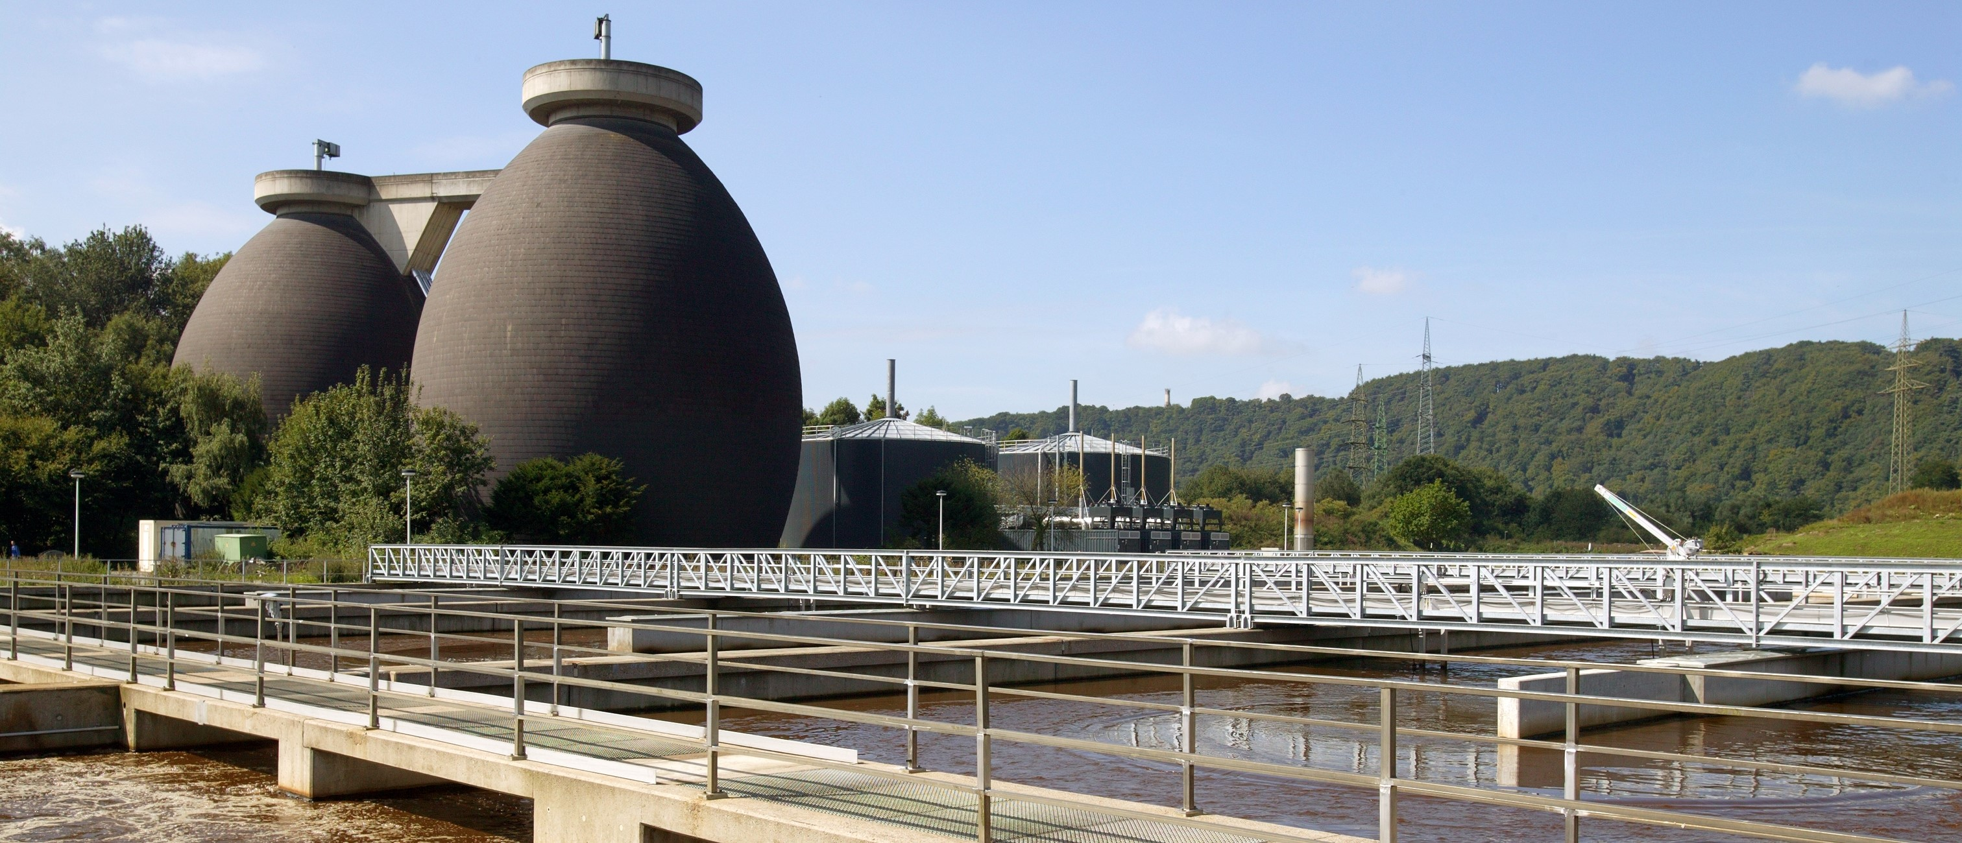
14th IWA Conference on
Instrumentation, Control and Automation
29 June-2nd July 2025 | Oslo – Norway
PRESENTATION TITLE
Author(s)
Affiliation(s)

